Slide 1
Reel change in FSL TJN
29Jul 2014

Slide 2
Description of Change
Qualify black reel in FSL TJN for T&R packing devices, keep the
same dimension and spec with current white reel. Only the color of reel was changed from white to black
Change Affect
Affected devices: All devices packed in tape and reel method
Affected packages: All packages
Affected PTI:N-,J-,M-,A-,R-,I-,V-,O-
Affected MBG: Digital Networking, Automotive MCU, Micro-controller,
Analog and Sensors, RF, Business Development , Cellular,
QComm

Slide 3
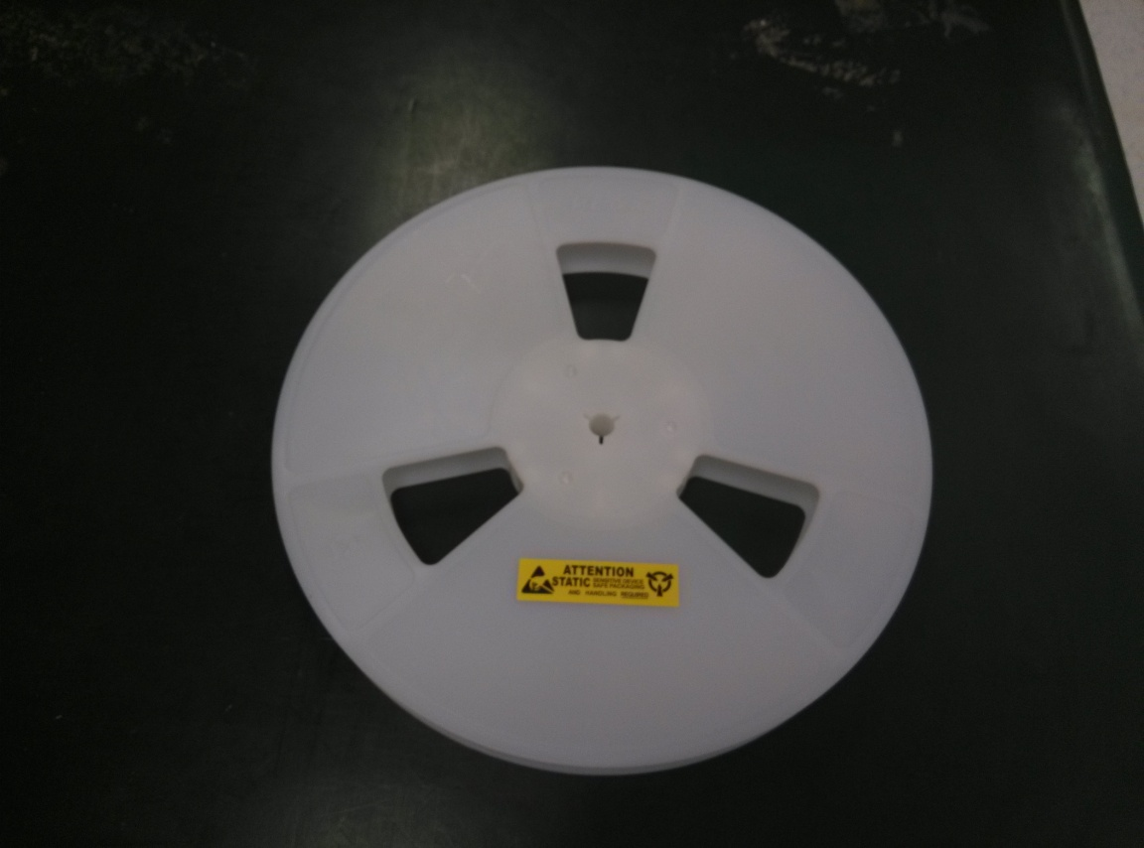
White Reel

Slide 4
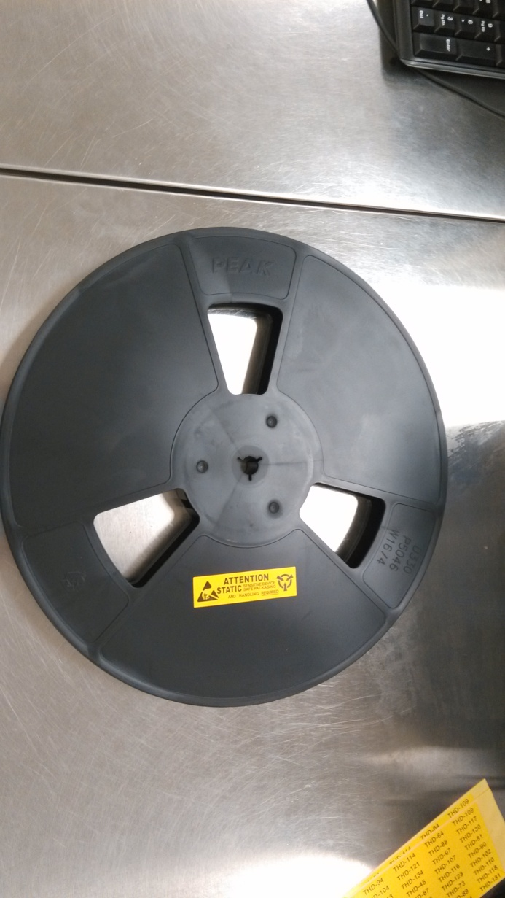
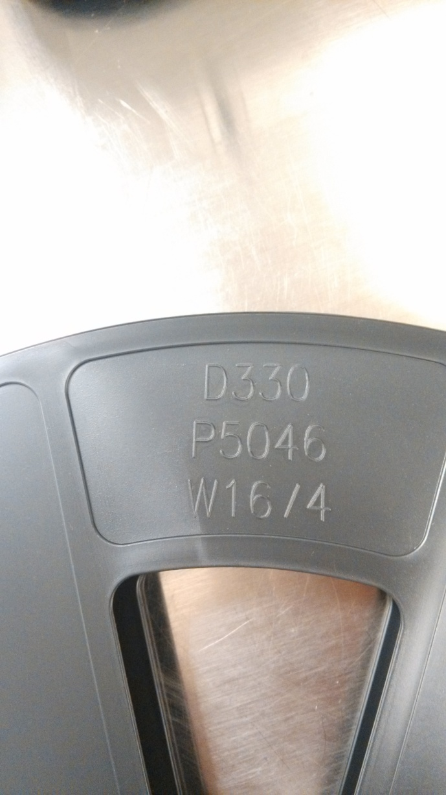
Black Reel

